Slide 1
CN:CST31209 : Deep Learning and Big Data Intelligence
JING WEN
Spring 2023
Lecture 5: Convolutional Neural Networks
Notes:
Where to put block multi-vector algorithms?
Percentage of Future Work
Diagram

Slide 2
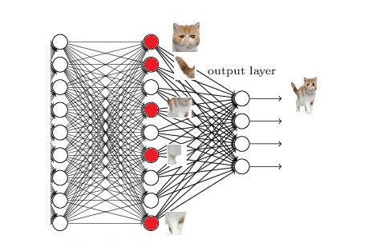


Slide 3
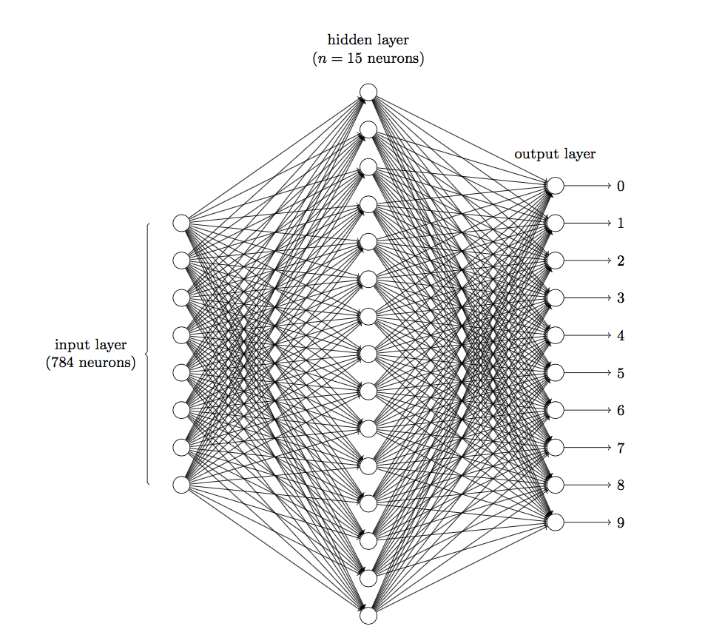
如果一个图像的尺寸是（28，28，1），即代表这个图像的是一个长宽均为28，channel为1的图像（channel也叫depth,此处1代表灰色图像）。如果使用全连接的网络结构，即，网络中的神经与与相邻层上的每个神经元均连接，那就意味着我们的网络有28 * 28 =784个神经元，hidden层采用了15个神经元，那么简单计算一下，我们需要的参数个数(w和b)就有：784*15*10+15+10=117625个
图 三层神经网络识别手写数字

Slide 4
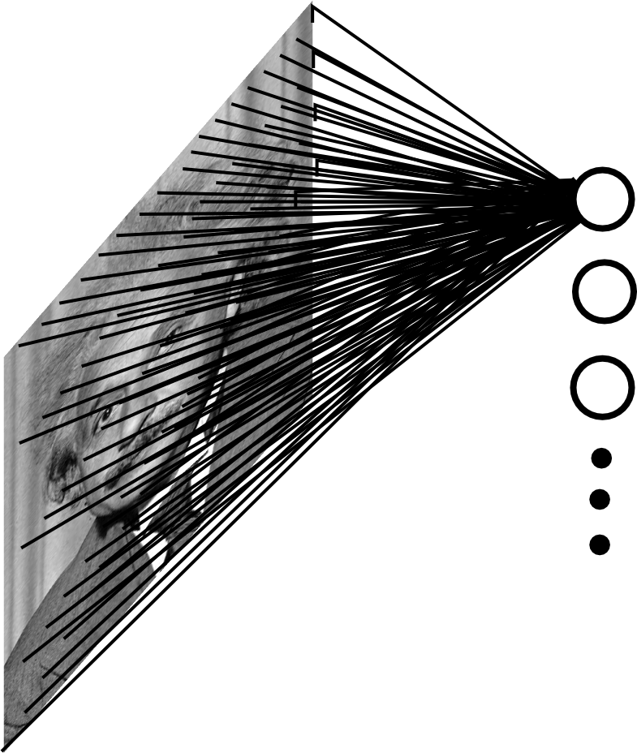

Fully Connected Layer
Example: 200x200 image
40K hidden units
~2B parameters!!!
- Spatial correlation is local
Waste of resources + we have not enough
training samples anyway..
Ranzato

Slide 5
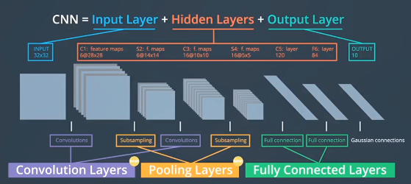

Slide 6

Convolutional Neural Networks
[LeNet-5, LeCun 1998]
Slides shamelessly borrowed from Karpathy, Ransato, Seitz, and Palmer

Slide 7
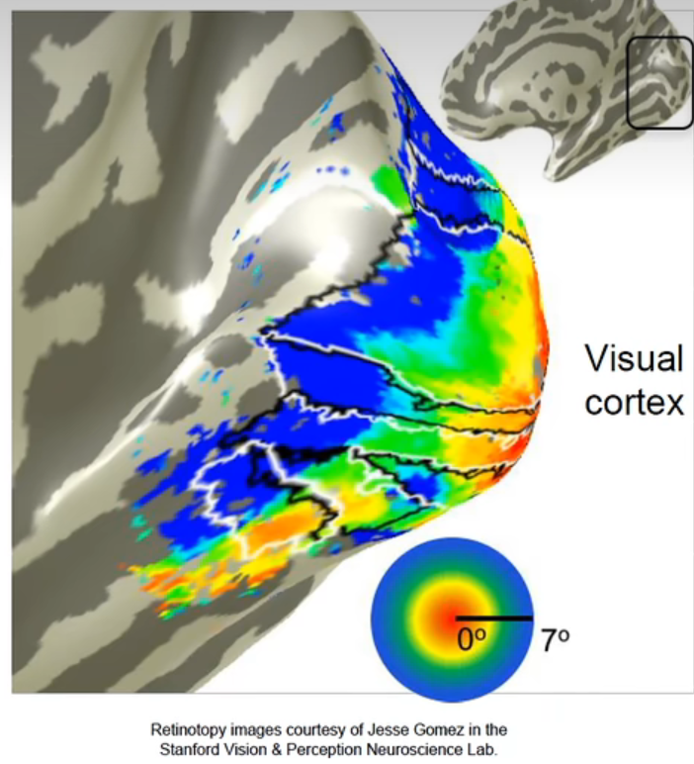

Slide 8
Cortical Receptive Fields
Simple Cells: “Line Detectors”
© Stephen E. Palmer, 2002

Slide 9
Cortical Receptive Fields
Simple Cells: “Edge Detectors”
© Stephen E. Palmer, 2002

Slide 10
Cortical Receptive Fields
Constructing a line detector
© Stephen E. Palmer, 2002

Slide 11
Cortical Receptive Fields
Complex Cells
0º
© Stephen E. Palmer, 2002

Slide 12
Cortical Receptive Fields
Complex Cells
60º
© Stephen E. Palmer, 2002

Slide 13
Cortical Receptive Fields
Complex Cells
90º
© Stephen E. Palmer, 2002

Slide 14
Cortical Receptive Fields
Complex Cells
120º
© Stephen E. Palmer, 2002

Slide 15
Cortical Receptive Fields
Constructing a Complex Cell
© Stephen E. Palmer, 2002

Slide 16
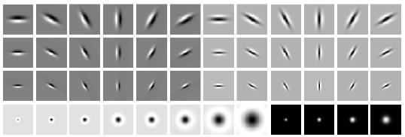
Modeling V1 in Computer Vision
LM Filter Bank
Code for filter banks: www.robots.ox.ac.uk/~vgg/research/texclass/filters.html

Slide 17
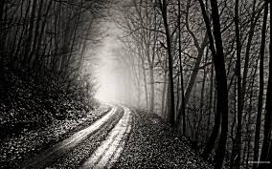
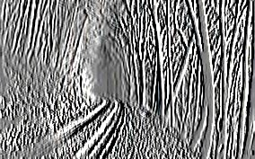
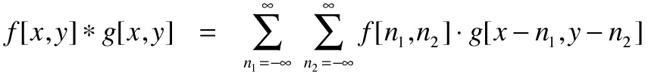
Convolutional of Two Signals
-1 0 1
-1 0 1
-1 0 1
*
=
elementwise multiplication and sum of a filter and the signal (image)
Ranzato

Slide 18

Image filtering
1
1
1
1
1
1
1
1
1
0 | 0 | 0 | 0 | 0 | 0 | 0 | 0 | 0 | 0
0 | 0 | 0 | 0 | 0 | 0 | 0 | 0 | 0 | 0
0 | 0 | 0 | 90 | 90 | 90 | 90 | 90 | 0 | 0
0 | 0 | 0 | 90 | 90 | 90 | 90 | 90 | 0 | 0
0 | 0 | 0 | 90 | 90 | 90 | 90 | 90 | 0 | 0
0 | 0 | 0 | 90 | 0 | 90 | 90 | 90 | 0 | 0
0 | 0 | 0 | 90 | 90 | 90 | 90 | 90 | 0 | 0
0 | 0 | 0 | 0 | 0 | 0 | 0 | 0 | 0 | 0
0 | 0 | 90 | 0 | 0 | 0 | 0 | 0 | 0 | 0
0 | 0 | 0 | 0 | 0 | 0 | 0 | 0 | 0 | 0
 | 0
0 | 0 | 0 | 0 | 0 | 0 | 0 | 0 | 0 | 0
0 | 0 | 0 | 0 | 0 | 0 | 0 | 0 | 0 | 0
0 | 0 | 0 | 90 | 90 | 90 | 90 | 90 | 0 | 0
0 | 0 | 0 | 90 | 90 | 90 | 90 | 90 | 0 | 0
0 | 0 | 0 | 90 | 90 | 90 | 90 | 90 | 0 | 0
0 | 0 | 0 | 90 | 0 | 90 | 90 | 90 | 0 | 0
0 | 0 | 0 | 90 | 90 | 90 | 90 | 90 | 0 | 0
0 | 0 | 0 | 0 | 0 | 0 | 0 | 0 | 0 | 0
0 | 0 | 90 | 0 | 0 | 0 | 0 | 0 | 0 | 0
0 | 0 | 0 | 0 | 0 | 0 | 0 | 0 | 0 | 0
Credit: S. Seitz
Notes:
ones, divide by 9

Slide 19
Image filtering
1
1
1
1
1
1
1
1
1
0 | 0 | 0 | 0 | 0 | 0 | 0 | 0 | 0 | 0
0 | 0 | 0 | 0 | 0 | 0 | 0 | 0 | 0 | 0
0 | 0 | 0 | 90 | 90 | 90 | 90 | 90 | 0 | 0
0 | 0 | 0 | 90 | 90 | 90 | 90 | 90 | 0 | 0
0 | 0 | 0 | 90 | 90 | 90 | 90 | 90 | 0 | 0
0 | 0 | 0 | 90 | 0 | 90 | 90 | 90 | 0 | 0
0 | 0 | 0 | 90 | 90 | 90 | 90 | 90 | 0 | 0
0 | 0 | 0 | 0 | 0 | 0 | 0 | 0 | 0 | 0
0 | 0 | 90 | 0 | 0 | 0 | 0 | 0 | 0 | 0
0 | 0 | 0 | 0 | 0 | 0 | 0 | 0 | 0 | 0
 | 0 | 10
0 | 0 | 0 | 0 | 0 | 0 | 0 | 0 | 0 | 0
0 | 0 | 0 | 0 | 0 | 0 | 0 | 0 | 0 | 0
0 | 0 | 0 | 90 | 90 | 90 | 90 | 90 | 0 | 0
0 | 0 | 0 | 90 | 90 | 90 | 90 | 90 | 0 | 0
0 | 0 | 0 | 90 | 90 | 90 | 90 | 90 | 0 | 0
0 | 0 | 0 | 90 | 0 | 90 | 90 | 90 | 0 | 0
0 | 0 | 0 | 90 | 90 | 90 | 90 | 90 | 0 | 0
0 | 0 | 0 | 0 | 0 | 0 | 0 | 0 | 0 | 0
0 | 0 | 90 | 0 | 0 | 0 | 0 | 0 | 0 | 0
0 | 0 | 0 | 0 | 0 | 0 | 0 | 0 | 0 | 0
Credit: S. Seitz
Notes:
ones, divide by 9

Slide 20
Image filtering
1
1
1
1
1
1
1
1
1
0 | 0 | 0 | 0 | 0 | 0 | 0 | 0 | 0 | 0
0 | 0 | 0 | 0 | 0 | 0 | 0 | 0 | 0 | 0
0 | 0 | 0 | 90 | 90 | 90 | 90 | 90 | 0 | 0
0 | 0 | 0 | 90 | 90 | 90 | 90 | 90 | 0 | 0
0 | 0 | 0 | 90 | 90 | 90 | 90 | 90 | 0 | 0
0 | 0 | 0 | 90 | 0 | 90 | 90 | 90 | 0 | 0
0 | 0 | 0 | 90 | 90 | 90 | 90 | 90 | 0 | 0
0 | 0 | 0 | 0 | 0 | 0 | 0 | 0 | 0 | 0
0 | 0 | 90 | 0 | 0 | 0 | 0 | 0 | 0 | 0
0 | 0 | 0 | 0 | 0 | 0 | 0 | 0 | 0 | 0
 | 0 | 10 | 20
0 | 0 | 0 | 0 | 0 | 0 | 0 | 0 | 0 | 0
0 | 0 | 0 | 0 | 0 | 0 | 0 | 0 | 0 | 0
0 | 0 | 0 | 90 | 90 | 90 | 90 | 90 | 0 | 0
0 | 0 | 0 | 90 | 90 | 90 | 90 | 90 | 0 | 0
0 | 0 | 0 | 90 | 90 | 90 | 90 | 90 | 0 | 0
0 | 0 | 0 | 90 | 0 | 90 | 90 | 90 | 0 | 0
0 | 0 | 0 | 90 | 90 | 90 | 90 | 90 | 0 | 0
0 | 0 | 0 | 0 | 0 | 0 | 0 | 0 | 0 | 0
0 | 0 | 90 | 0 | 0 | 0 | 0 | 0 | 0 | 0
0 | 0 | 0 | 0 | 0 | 0 | 0 | 0 | 0 | 0
Credit: S. Seitz
Notes:
ones, divide by 9

Slide 21
Image filtering
1
1
1
1
1
1
1
1
1
0 | 0 | 0 | 0 | 0 | 0 | 0 | 0 | 0 | 0
0 | 0 | 0 | 0 | 0 | 0 | 0 | 0 | 0 | 0
0 | 0 | 0 | 90 | 90 | 90 | 90 | 90 | 0 | 0
0 | 0 | 0 | 90 | 90 | 90 | 90 | 90 | 0 | 0
0 | 0 | 0 | 90 | 90 | 90 | 90 | 90 | 0 | 0
0 | 0 | 0 | 90 | 0 | 90 | 90 | 90 | 0 | 0
0 | 0 | 0 | 90 | 90 | 90 | 90 | 90 | 0 | 0
0 | 0 | 0 | 0 | 0 | 0 | 0 | 0 | 0 | 0
0 | 0 | 90 | 0 | 0 | 0 | 0 | 0 | 0 | 0
0 | 0 | 0 | 0 | 0 | 0 | 0 | 0 | 0 | 0
 | 0 | 10 | 20 | 30
0 | 0 | 0 | 0 | 0 | 0 | 0 | 0 | 0 | 0
0 | 0 | 0 | 0 | 0 | 0 | 0 | 0 | 0 | 0
0 | 0 | 0 | 90 | 90 | 90 | 90 | 90 | 0 | 0
0 | 0 | 0 | 90 | 90 | 90 | 90 | 90 | 0 | 0
0 | 0 | 0 | 90 | 90 | 90 | 90 | 90 | 0 | 0
0 | 0 | 0 | 90 | 0 | 90 | 90 | 90 | 0 | 0
0 | 0 | 0 | 90 | 90 | 90 | 90 | 90 | 0 | 0
0 | 0 | 0 | 0 | 0 | 0 | 0 | 0 | 0 | 0
0 | 0 | 90 | 0 | 0 | 0 | 0 | 0 | 0 | 0
0 | 0 | 0 | 0 | 0 | 0 | 0 | 0 | 0 | 0
Credit: S. Seitz
Notes:
ones, divide by 9

Slide 22
Image filtering
1
1
1
1
1
1
1
1
1
0 | 0 | 0 | 0 | 0 | 0 | 0 | 0 | 0 | 0
0 | 0 | 0 | 0 | 0 | 0 | 0 | 0 | 0 | 0
0 | 0 | 0 | 90 | 90 | 90 | 90 | 90 | 0 | 0
0 | 0 | 0 | 90 | 90 | 90 | 90 | 90 | 0 | 0
0 | 0 | 0 | 90 | 90 | 90 | 90 | 90 | 0 | 0
0 | 0 | 0 | 90 | 0 | 90 | 90 | 90 | 0 | 0
0 | 0 | 0 | 90 | 90 | 90 | 90 | 90 | 0 | 0
0 | 0 | 0 | 0 | 0 | 0 | 0 | 0 | 0 | 0
0 | 0 | 90 | 0 | 0 | 0 | 0 | 0 | 0 | 0
0 | 0 | 0 | 0 | 0 | 0 | 0 | 0 | 0 | 0
 | 0 | 10 | 20 | 30 | 30
Credit: S. Seitz
Notes:
ones, divide by 9

Slide 23
Image filtering
1
1
1
1
1
1
1
1
1
0 | 0 | 0 | 0 | 0 | 0 | 0 | 0 | 0 | 0
0 | 0 | 0 | 0 | 0 | 0 | 0 | 0 | 0 | 0
0 | 0 | 0 | 90 | 90 | 90 | 90 | 90 | 0 | 0
0 | 0 | 0 | 90 | 90 | 90 | 90 | 90 | 0 | 0
0 | 0 | 0 | 90 | 90 | 90 | 90 | 90 | 0 | 0
0 | 0 | 0 | 90 | 0 | 90 | 90 | 90 | 0 | 0
0 | 0 | 0 | 90 | 90 | 90 | 90 | 90 | 0 | 0
0 | 0 | 0 | 0 | 0 | 0 | 0 | 0 | 0 | 0
0 | 0 | 90 | 0 | 0 | 0 | 0 | 0 | 0 | 0
0 | 0 | 0 | 0 | 0 | 0 | 0 | 0 | 0 | 0
 | 0 | 10 | 20 | 30 | 30
?
Credit: S. Seitz
Notes:
ones, divide by 9

Slide 24
Image filtering
1
1
1
1
1
1
1
1
1
0 | 0 | 0 | 0 | 0 | 0 | 0 | 0 | 0 | 0
0 | 0 | 0 | 0 | 0 | 0 | 0 | 0 | 0 | 0
0 | 0 | 0 | 90 | 90 | 90 | 90 | 90 | 0 | 0
0 | 0 | 0 | 90 | 90 | 90 | 90 | 90 | 0 | 0
0 | 0 | 0 | 90 | 90 | 90 | 90 | 90 | 0 | 0
0 | 0 | 0 | 90 | 0 | 90 | 90 | 90 | 0 | 0
0 | 0 | 0 | 90 | 90 | 90 | 90 | 90 | 0 | 0
0 | 0 | 0 | 0 | 0 | 0 | 0 | 0 | 0 | 0
0 | 0 | 90 | 0 | 0 | 0 | 0 | 0 | 0 | 0
0 | 0 | 0 | 0 | 0 | 0 | 0 | 0 | 0 | 0
 | 0 | 10 | 20 | 30 | 30
 |  |  |  | 50
?
Credit: S. Seitz
Notes:
ones, divide by 9

Slide 25
Image filtering
1
1
1
1
1
1
1
1
1
0 | 0 | 0 | 0 | 0 | 0 | 0 | 0 | 0 | 0
0 | 0 | 0 | 0 | 0 | 0 | 0 | 0 | 0 | 0
0 | 0 | 0 | 90 | 90 | 90 | 90 | 90 | 0 | 0
0 | 0 | 0 | 90 | 90 | 90 | 90 | 90 | 0 | 0
0 | 0 | 0 | 90 | 90 | 90 | 90 | 90 | 0 | 0
0 | 0 | 0 | 90 | 0 | 90 | 90 | 90 | 0 | 0
0 | 0 | 0 | 90 | 90 | 90 | 90 | 90 | 0 | 0
0 | 0 | 0 | 0 | 0 | 0 | 0 | 0 | 0 | 0
0 | 0 | 90 | 0 | 0 | 0 | 0 | 0 | 0 | 0
0 | 0 | 0 | 0 | 0 | 0 | 0 | 0 | 0 | 0
 | 0 | 10 | 20 | 30 | 30 | 30 | 20 | 10
 | 0 | 20 | 40 | 60 | 60 | 60 | 40 | 20
 | 0 | 30 | 60 | 90 | 90 | 90 | 60 | 30
 | 0 | 30 | 50 | 80 | 80 | 90 | 60 | 30
 | 0 | 30 | 50 | 80 | 80 | 90 | 60 | 30
 | 0 | 20 | 30 | 50 | 50 | 60 | 40 | 20
 | 10 | 20 | 30 | 30 | 30 | 30 | 20 | 10
 | 10 | 10 | 10 | 0 | 0 | 0 | 0 | 0
Credit: S. Seitz

Slide 26
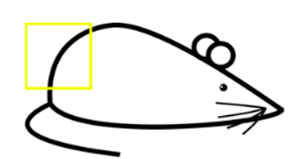
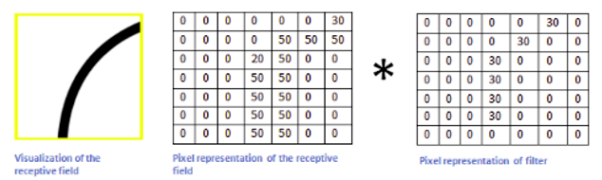
Convolution
mask
Multiplication and Summation=50*30+20*30+50*30+50*30+50*30=6600

Slide 27
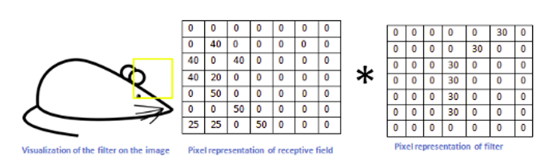
Convolution
Multiplication and Summation=0

Slide 28
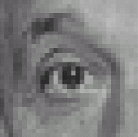
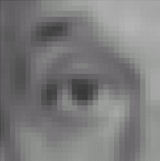
Linear filters: examples
1
1
1
=
1
1
1
1
1
1
Original
Blur (with a mean filter)
Source: D. Lowe

Slide 29
Practice with linear filters
0
0
0
?
0
1
0
0
0
0
Original
Source: D. Lowe

Slide 30
Practice with linear filters
0
0
0
0
1
0
0
0
0
Original
Filtered
(no change)
Source: D. Lowe

Slide 31
Practice with linear filters
0
0
0
?
0
0
1
0
0
0
Original
Source: D. Lowe

Slide 32
Practice with linear filters
0
0
0
0
0
1
0
0
0
Original
Shifted left
By 1 pixel
Source: D. Lowe

Slide 33
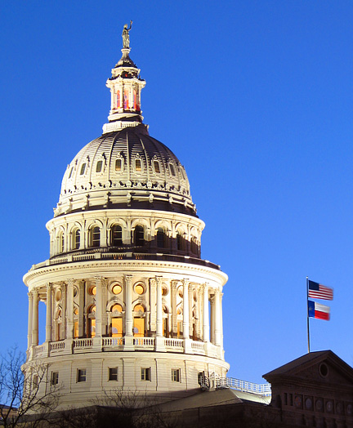
Image from http://www.texasexplorer.com/austincap2.jpg
Kristen Grauman

Slide 34
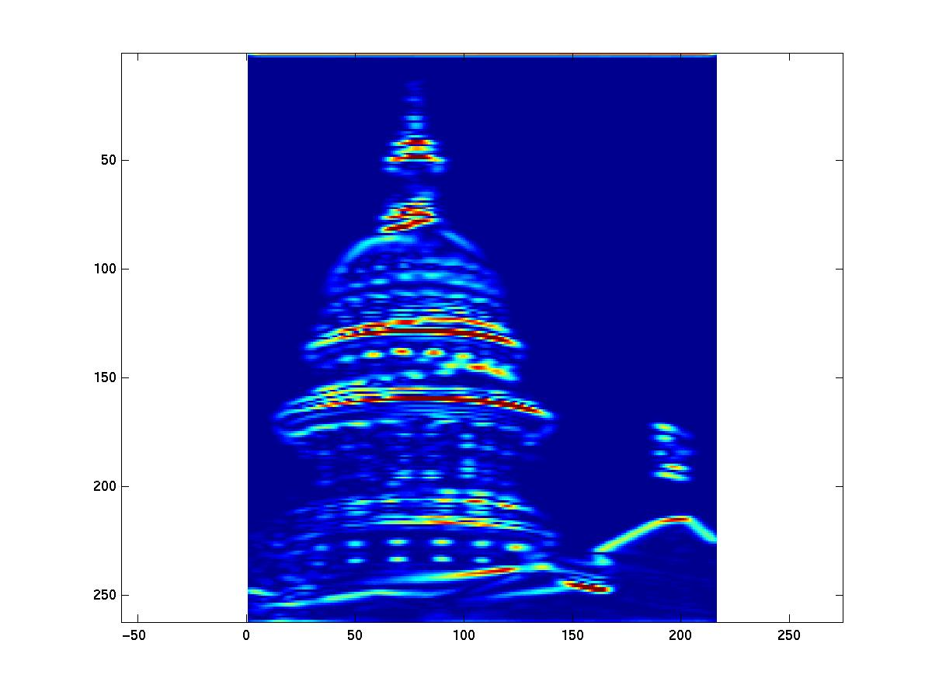
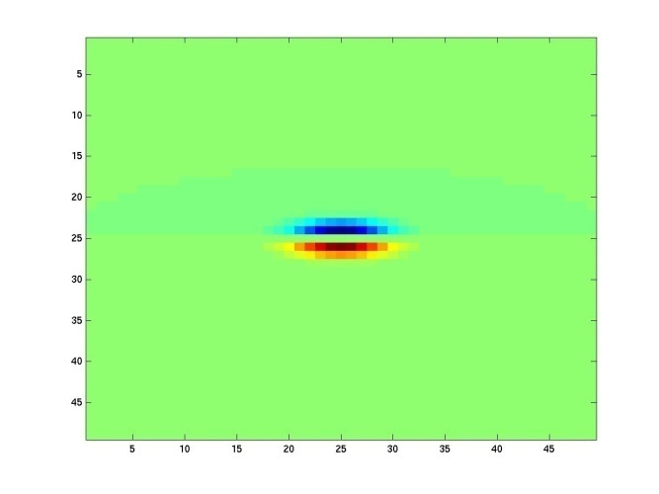
Showing magnitude of responses
Kristen Grauman

Slide 35
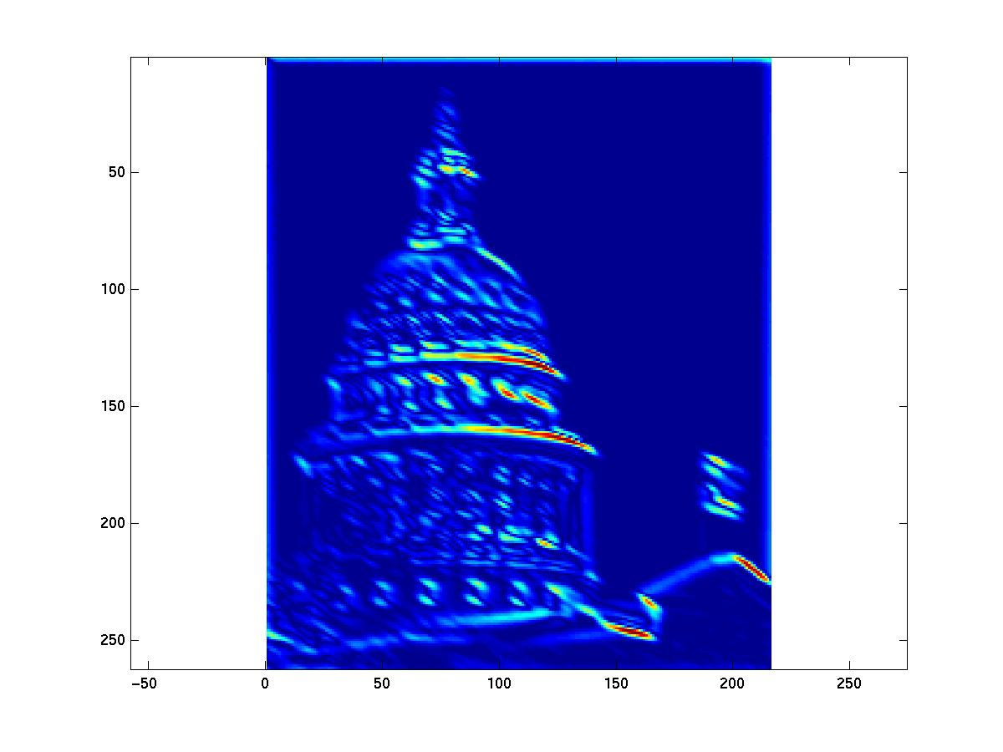
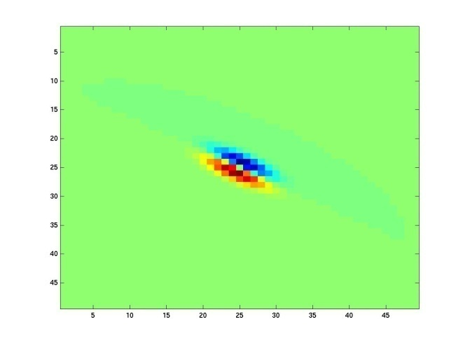
Kristen Grauman
Notes:
2

Slide 36
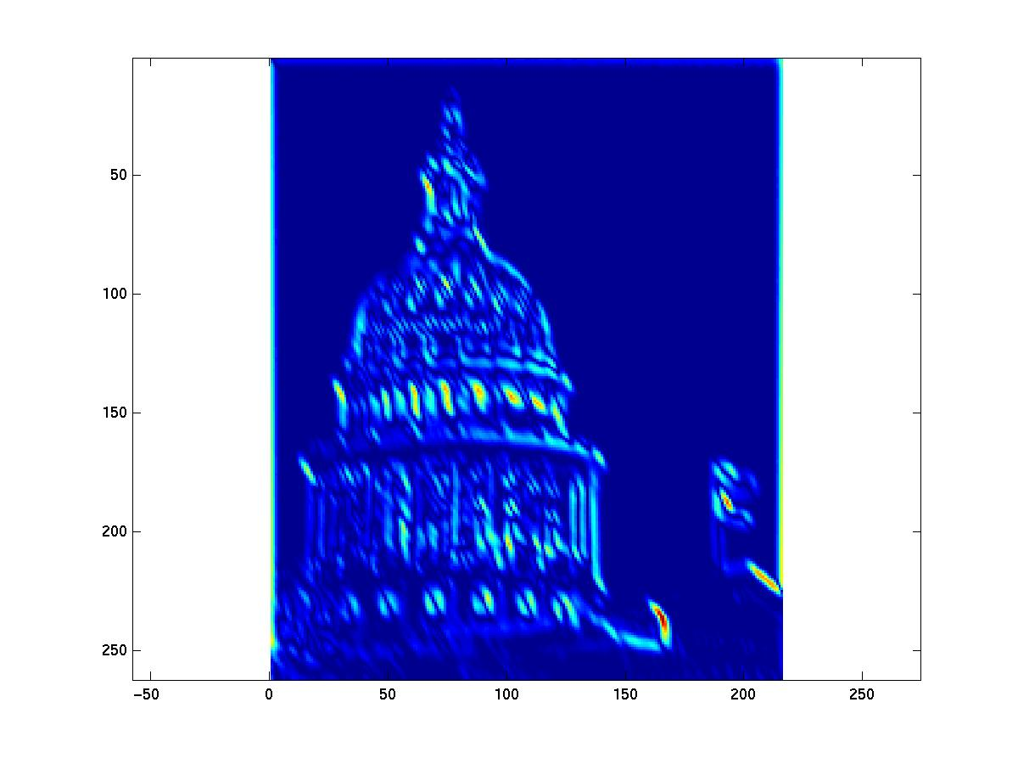
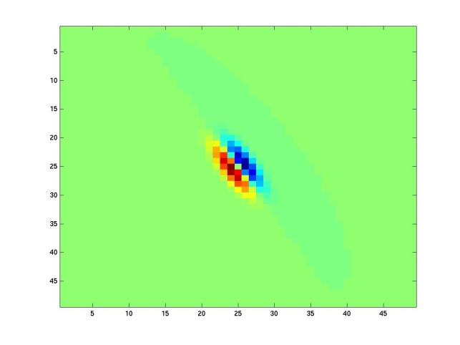
Kristen Grauman
Notes:
3

Slide 37
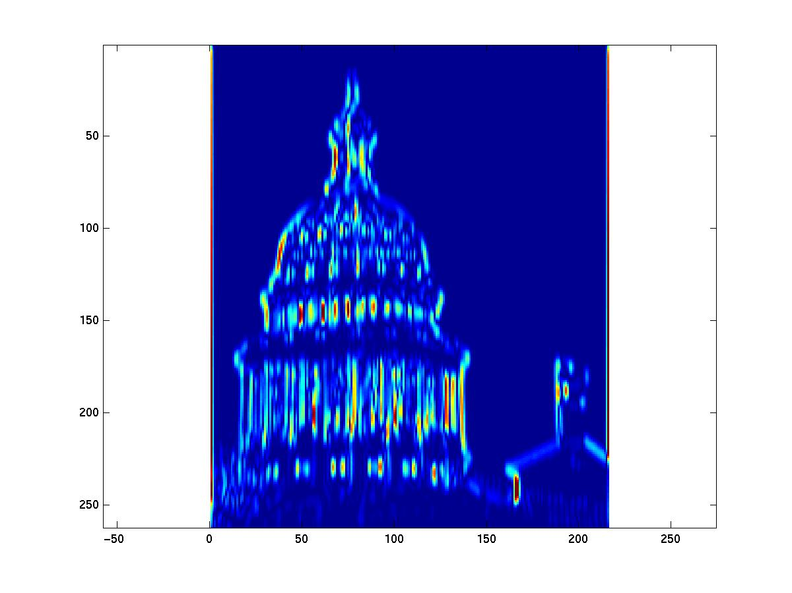
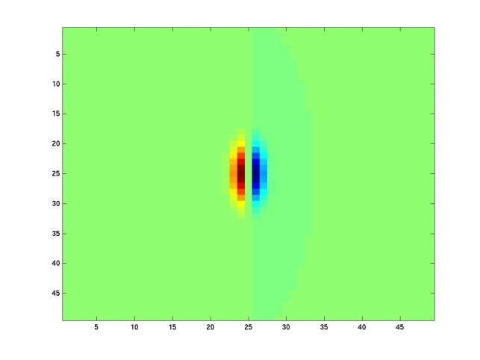
Kristen Grauman
Notes:
4

Slide 38
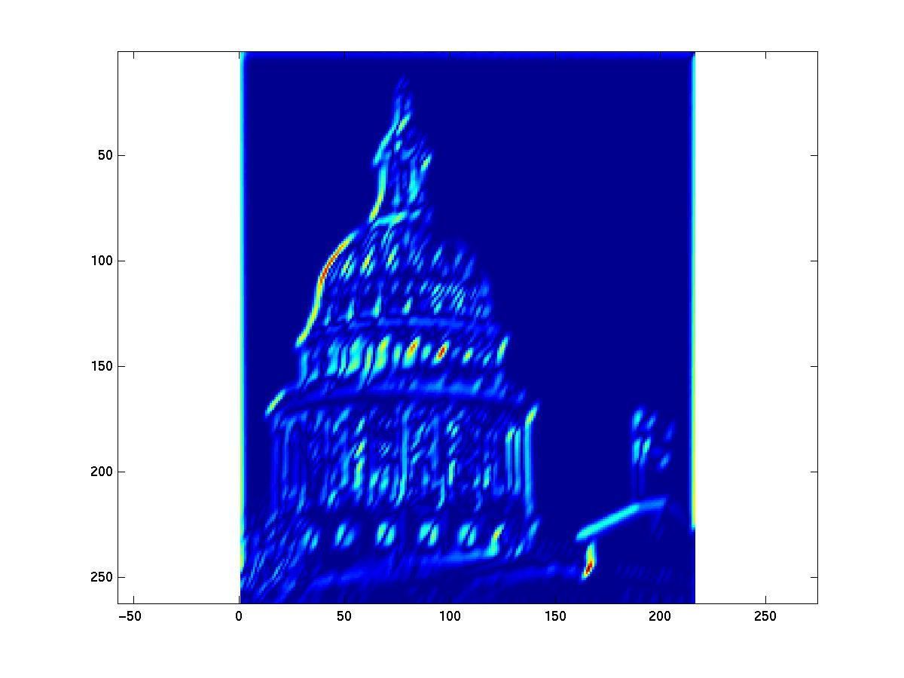
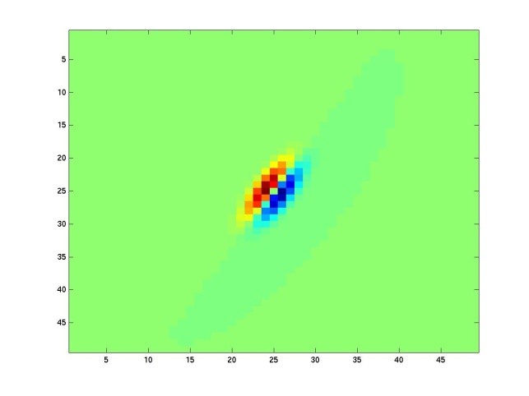
Kristen Grauman

Slide 39
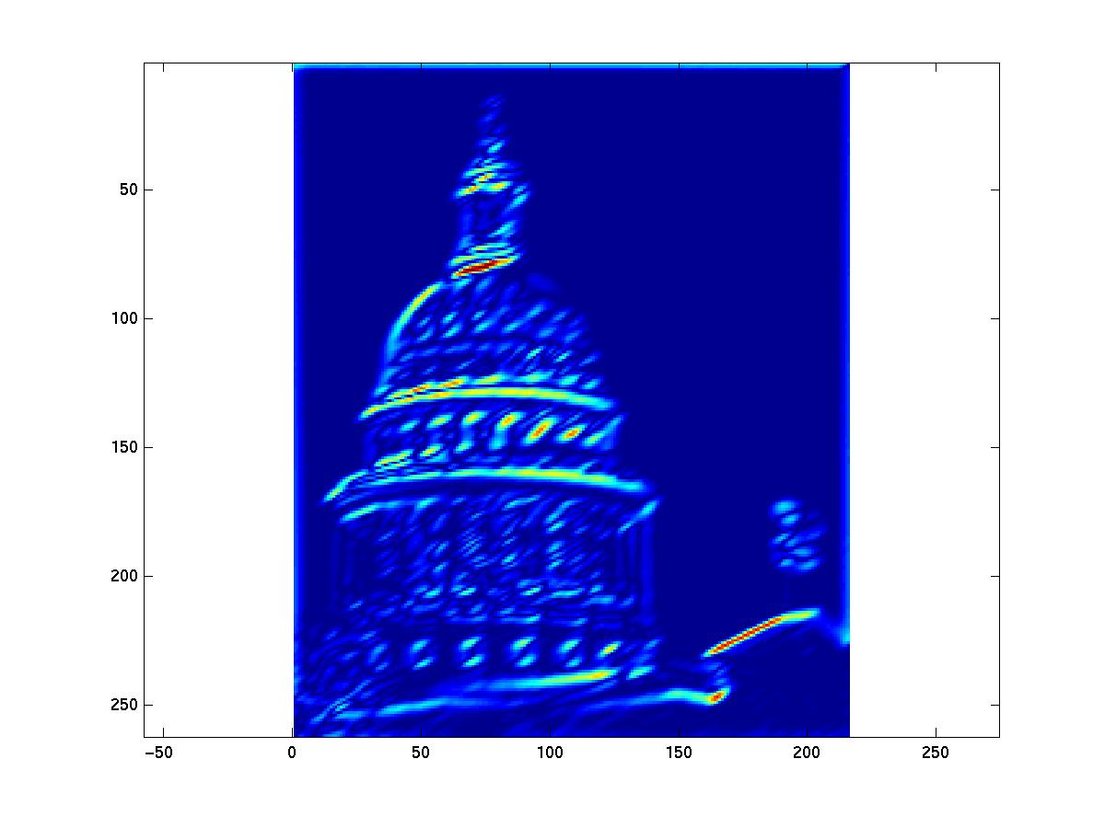
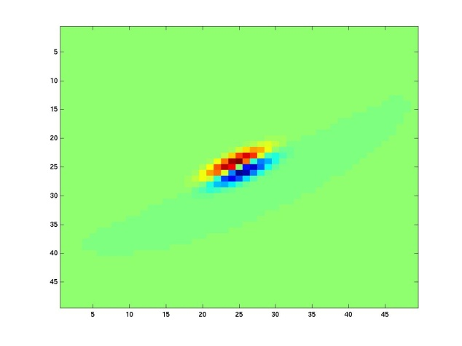
Kristen Grauman
Notes:
6

Slide 40
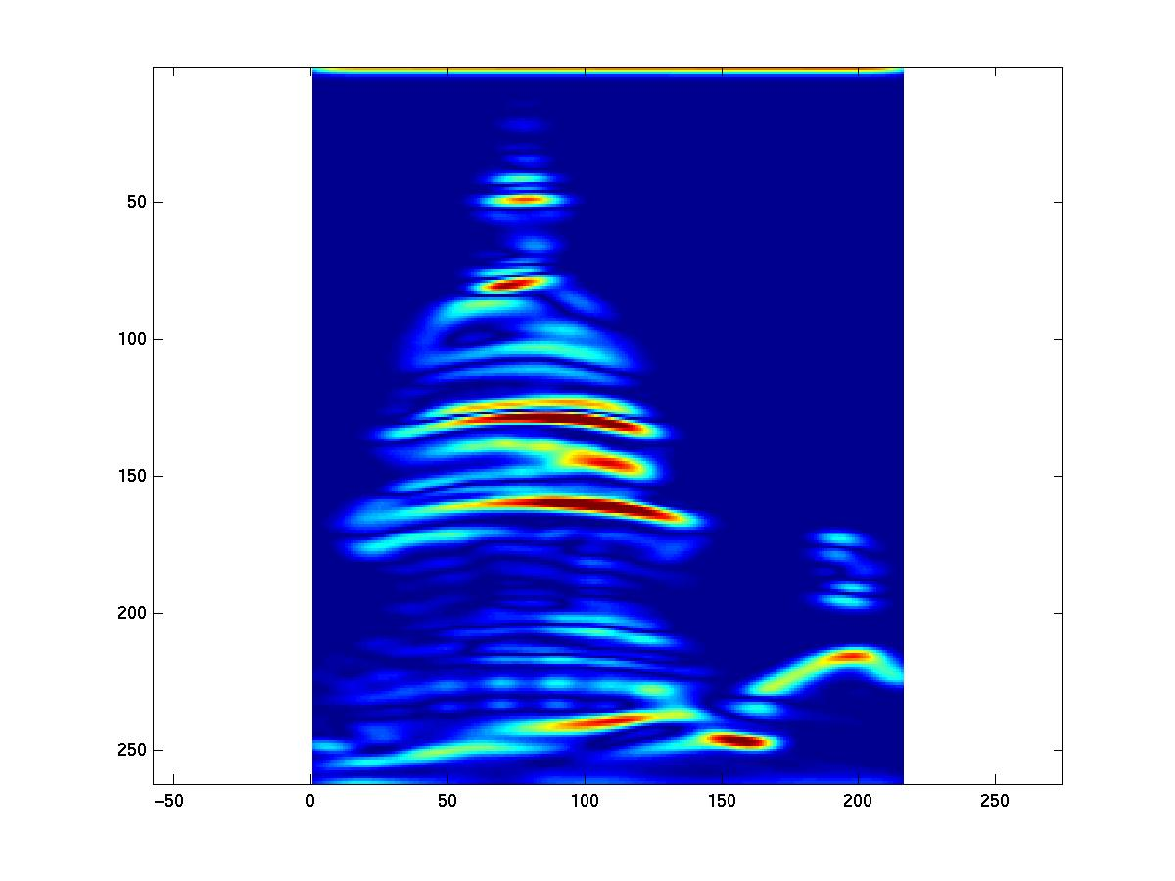
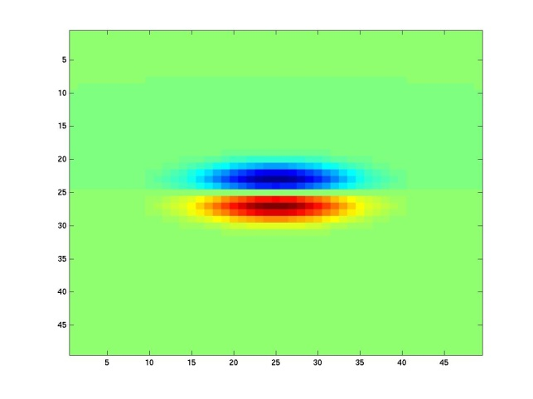
Kristen Grauman
Notes:
7

Slide 41
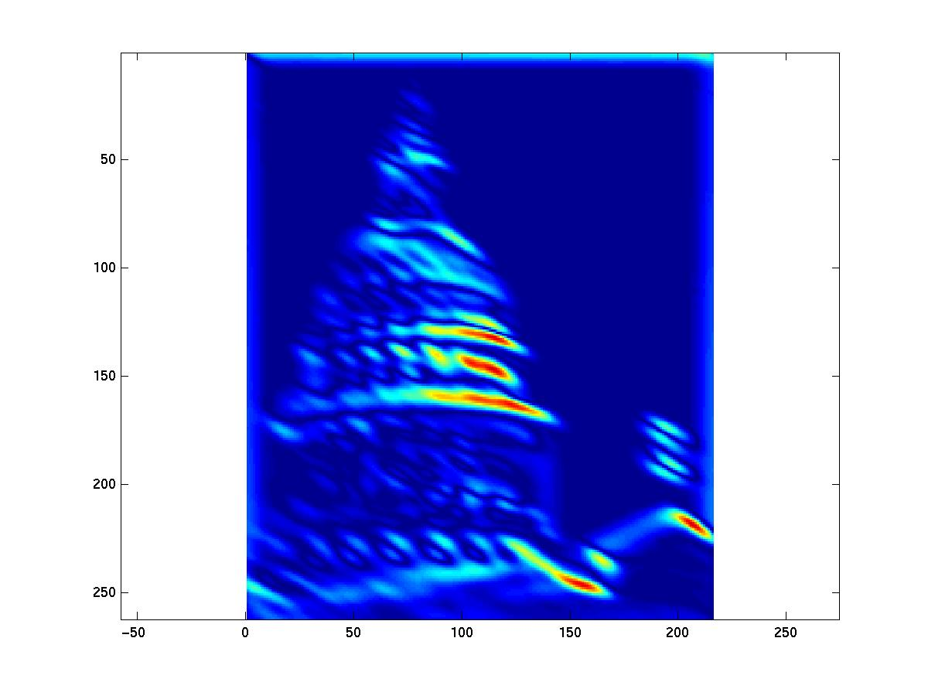
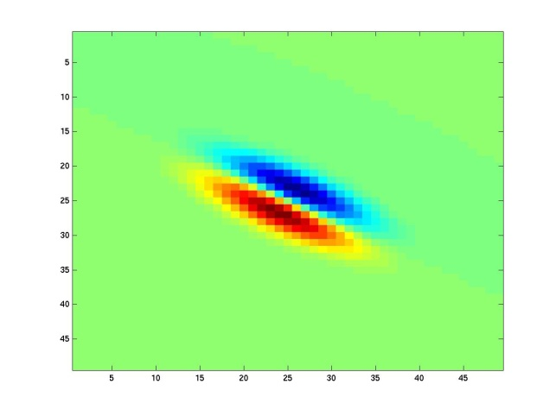
Kristen Grauman
Notes:
8

Slide 42
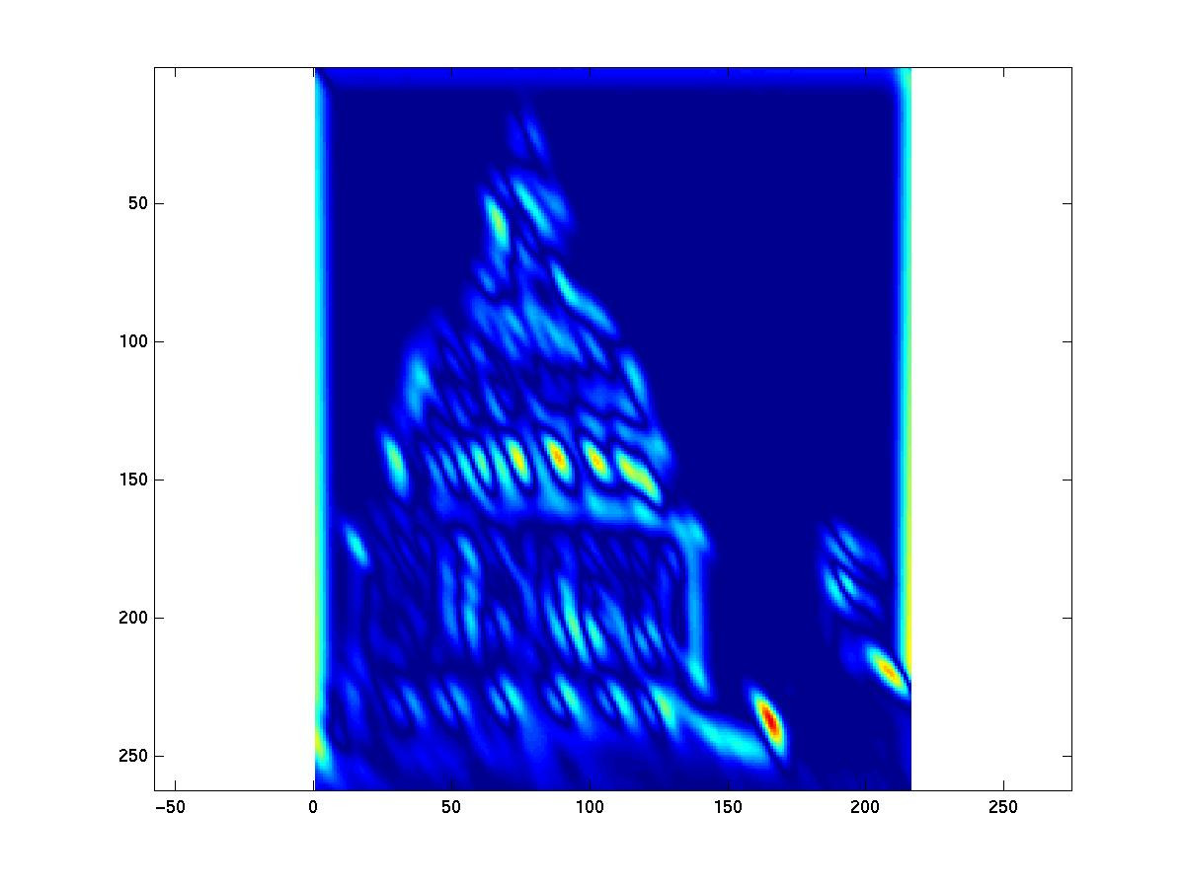
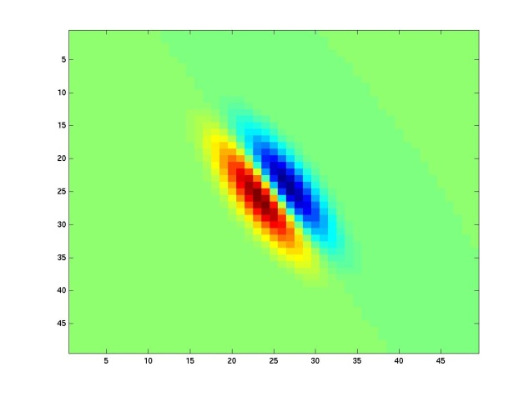
Kristen Grauman
Notes:
9

Slide 43
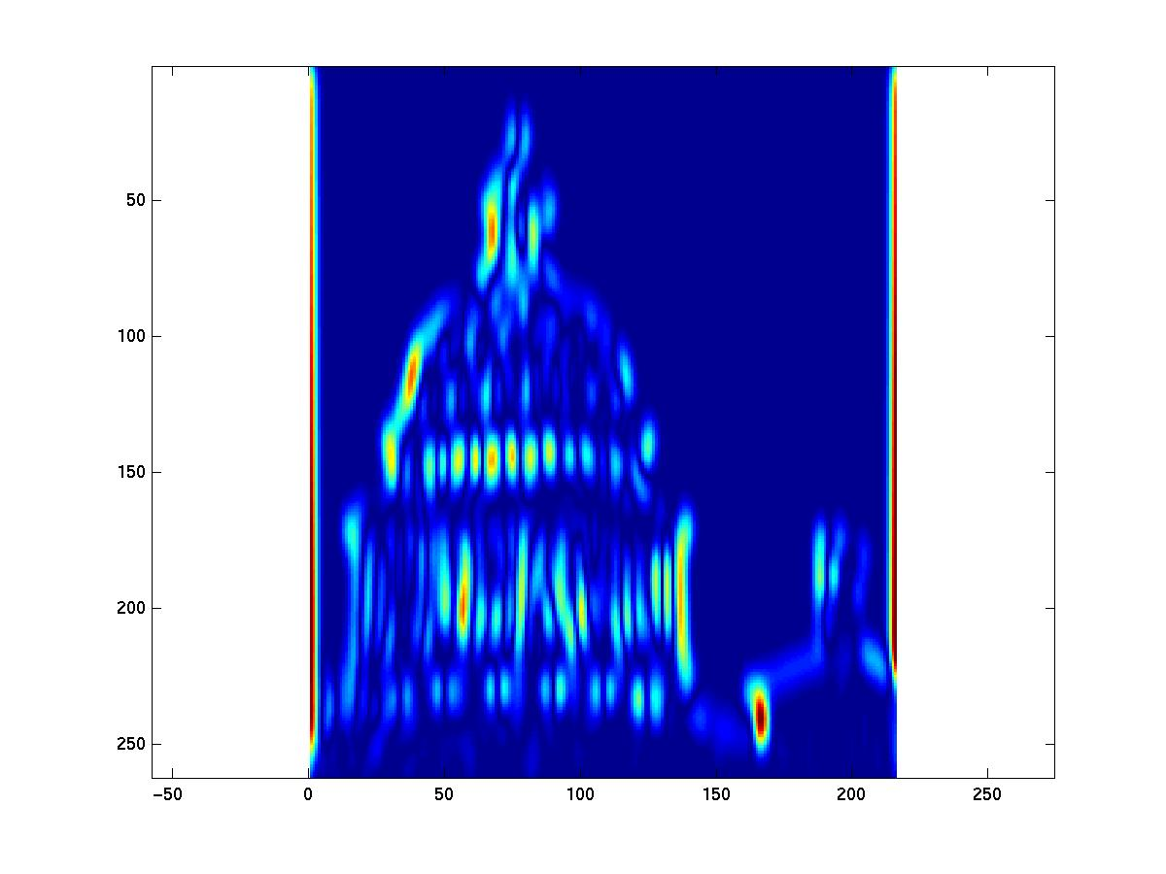
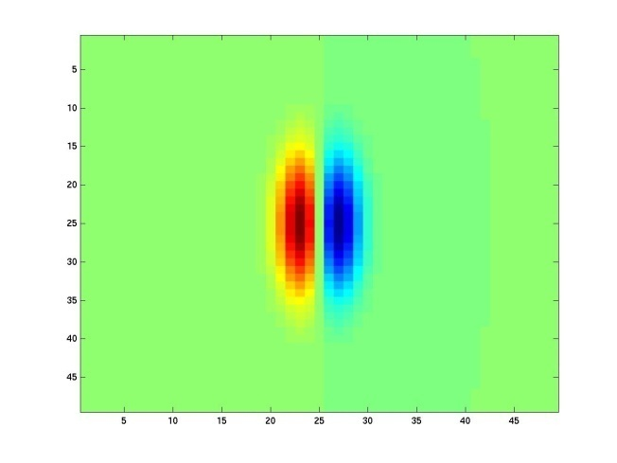
Kristen Grauman
Notes:
10

Slide 44
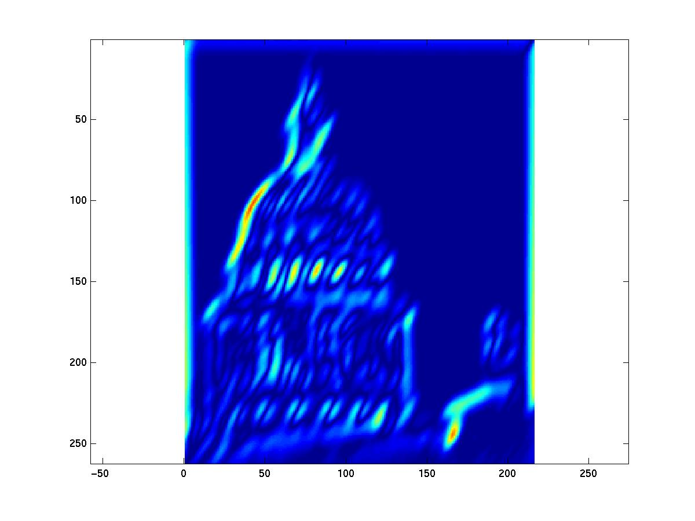
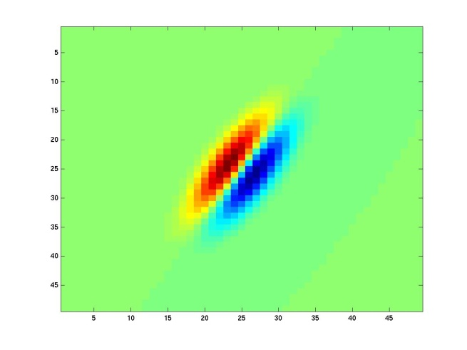
Kristen Grauman
Notes:
11

Slide 45
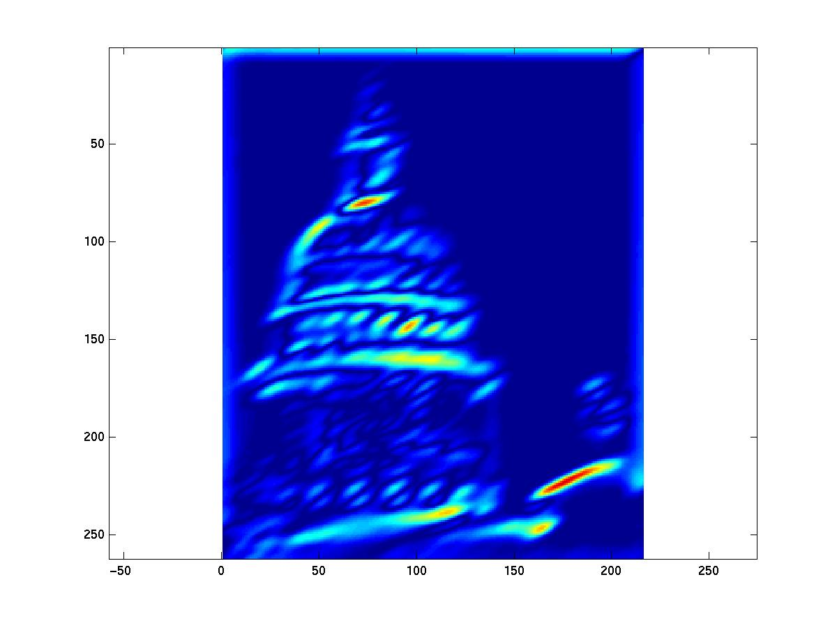
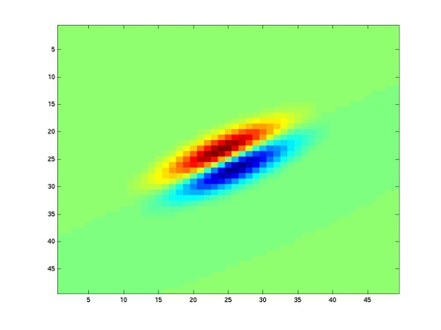
Kristen Grauman
Notes:
12

Slide 46
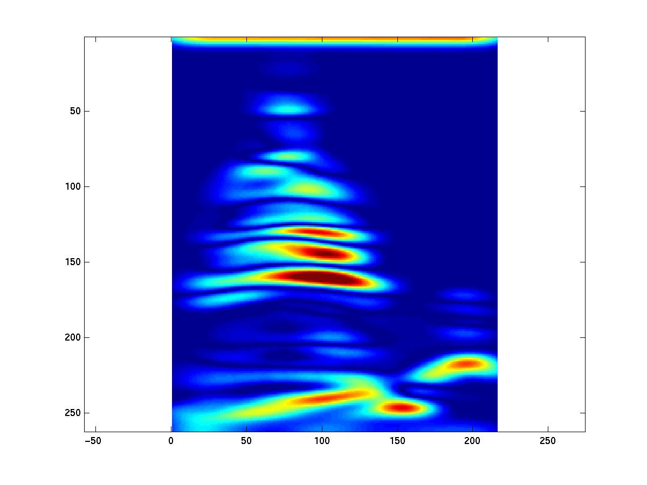
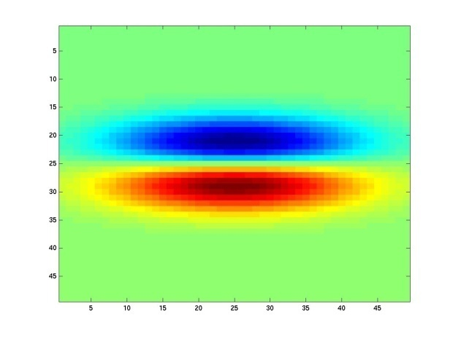
Kristen Grauman
Notes:
13

Slide 47
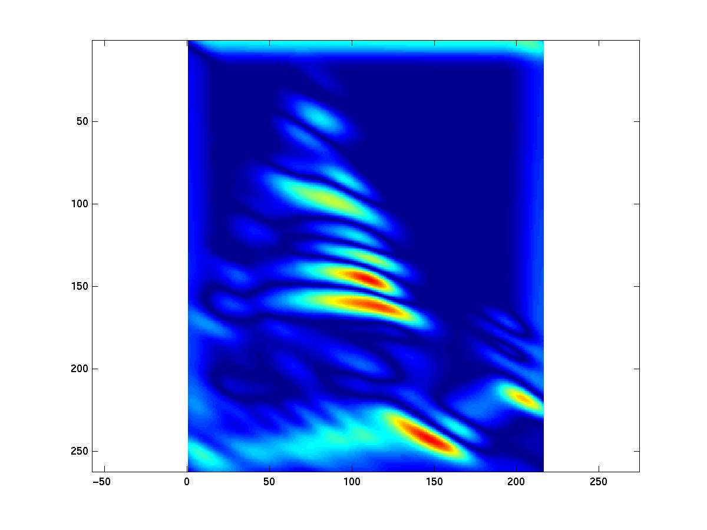
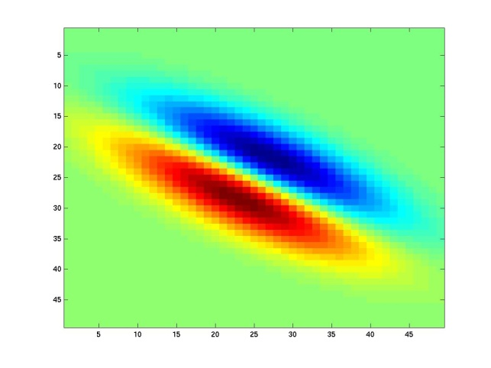
Kristen Grauman
Notes:
14

Slide 48
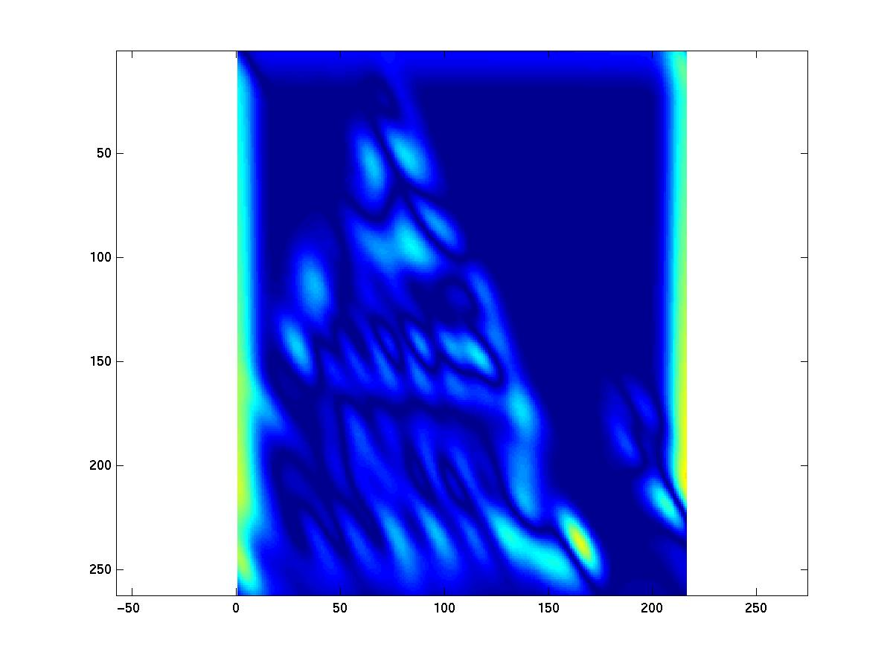
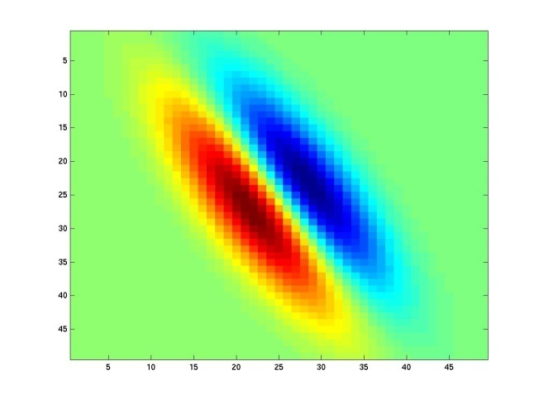
Kristen Grauman
Notes:
15

Slide 49
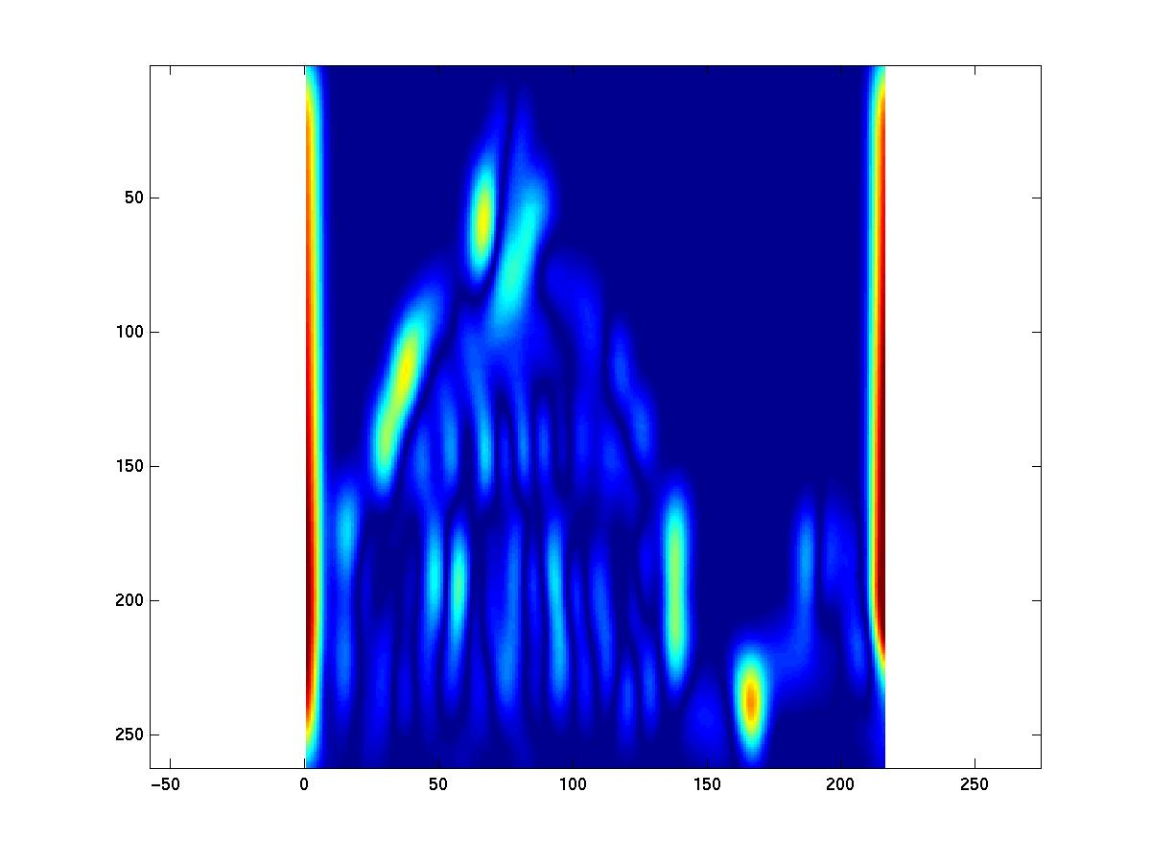
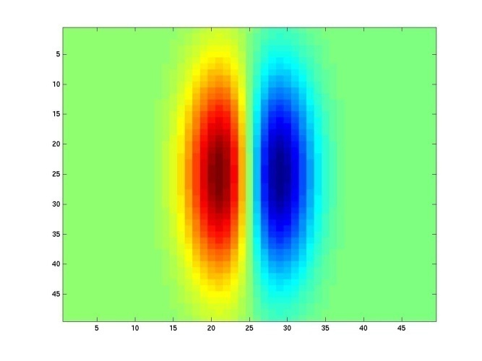
Kristen Grauman
Notes:
16

Slide 50
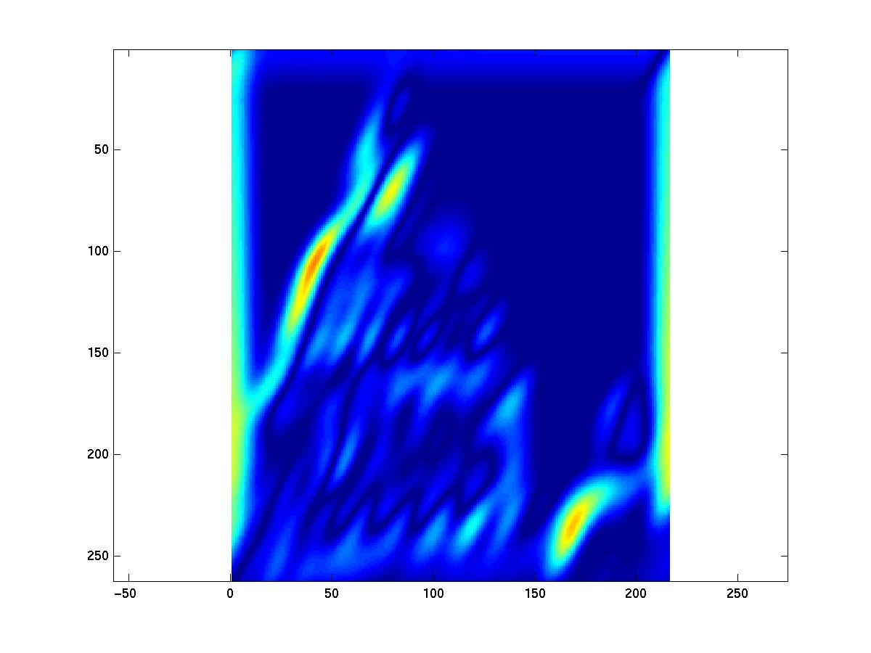
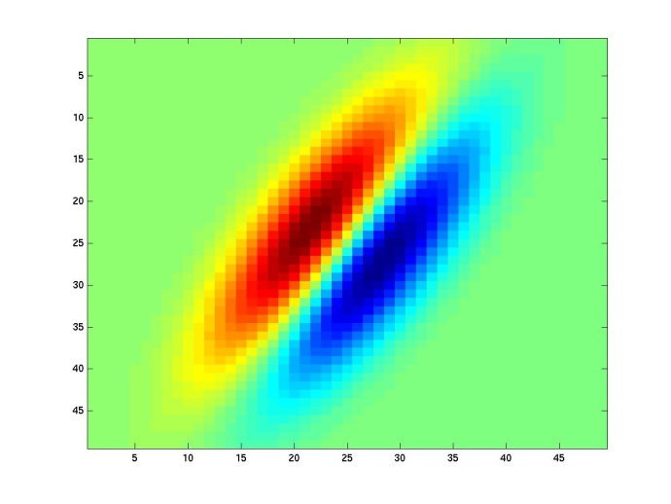
Kristen Grauman

Slide 51
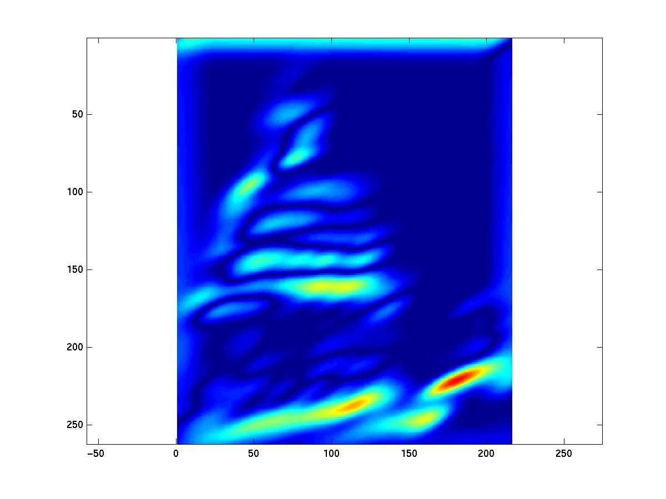

Kristen Grauman
Notes:
18

Slide 52






Can you match the texture to the response?
Filters
A
B
1
2
C
3
Mean abs responses

Slide 53

Fully Connected Layer
Notes:
丢失空间信息

Slide 54
Fully Connected Layer
Example: 200x200 image
40K hidden units
~2B parameters!!!
- Spatial correlation is local
Waste of resources + we have not enough
training samples anyway..
Ranzato

Slide 55

Convolutional Layer
Ranzato

Slide 56

Convolutional Layer
Ranzato

Slide 57

Convolutional Layer
Ranzato

Slide 58

Convolutional Layer
Ranzato

Slide 59

Convolutional Layer
Ranzato

Slide 60

Convolutional Layer
Ranzato

Slide 61

Convolutional Layer
Ranzato

Slide 62

Convolutional Layer
Ranzato

Slide 63

Convolutional Layer
Ranzato

Slide 64

Convolutional Layer
Ranzato

Slide 65

Convolutional Layer
Ranzato

Slide 66

Convolutional Layer
Ranzato

Slide 67

Convolutional Layer
Ranzato

Slide 68

Convolutional Layer
Ranzato

Slide 69

Convolutional Layer
Ranzato

Slide 70

Convolutional Layer

Slide 71


Slide 72

https://github.com/vdumoulin/conv_arithmetic

Slide 73


Convolutional Layer
Learn multiple filters.
E.g.: 200x200 image
100 Filters
Filter size: 10x10
10K parameters
Ranzato

Slide 74
before:
output layer
input layer
hidden layer
now:

Slide 75



Convolutions on RGB image
One convolution kernel(filter)

Slide 76


Slide 77


Slide 78


Slide 79


Slide 80
Convolution Layer
32x32x3 image
32
height
32
width
3
depth

Slide 81
Convolution Layer
32x32x3 image
5x5x3 filter
32
Convolve the filter with the image
i.e. “slide over the image spatially, computing dot products”
32
3

Slide 82
Convolution Layer
Filters always extend the full depth of the input volume
32x32x3 image
5x5x3 filter
32
Convolve the filter with the image
i.e. “slide over the image spatially, computing dot products”
32
3

Slide 83


Convolution Layer
32x32x3 image
5x5x3 filter
32
1 number:
the result of taking a dot product between the filter and a small 5x5x3 chunk of the image
(i.e. 5*5*3 = 75-dimensional dot product + bias)
32
3

Slide 84
Convolution Layer
activation map
32x32x3 image
5x5x3 filter
32
28
convolve (slide) over all spatial locations
32
28
3
1

Slide 85
consider a second, green filter
Convolution Layer
32x32x3 image
5x5x3 filter
activation maps
32
28
convolve (slide) over all spatial locations
32
28
3
1

Slide 86
For example, if we had 6 5x5 filters, we’ll get 6 separate activation maps:
activation maps
32
28
Convolution Layer
32
28
3
6
We stack these up to get a “new image” of size 28x28x6!

Slide 87
Preview: ConvNet is a sequence of Convolution Layers, interspersed with activation functions
32
28
CONV,
ReLU
e.g. 6 5x5x3 filters
32
28
3
6

Slide 88
Preview: ConvNet is a sequence of Convolutional Layers, interspersed with activation functions
32
28
24
….
CONV,
ReLU
e.g. 6 5x5x3 filters
CONV,
ReLU
e.g. 10 5x5x6 filters
CONV,
ReLU
32
28
24
3
6
10

Slide 89

Preview
[From recent Yann LeCun slides]

Slide 90

Preview
[From recent Yann LeCun slides]

Slide 91


Slide 92


convolving the first filter in the input gives the first slice of depth in output volume

Slide 93
A closer look at spatial dimensions:
activation map
32x32x3 image
5x5x3 filter
32
28
convolve (slide) over all spatial locations
32
28
3
1

Slide 94
A closer look at spatial dimensions:
7
7x7 input (spatially)
assume 3x3 filter
7

Slide 95
A closer look at spatial dimensions:
7
7x7 input (spatially)
assume 3x3 filter
7

Slide 96
A closer look at spatial dimensions:
7
7x7 input (spatially)
assume 3x3 filter
7

Slide 97
A closer look at spatial dimensions:
7
7x7 input (spatially)
assume 3x3 filter
7

Slide 98
A closer look at spatial dimensions:
7
7x7 input (spatially)
assume 3x3 filter
=> 5x5 output
7

Slide 99
A closer look at spatial dimensions:
7
7x7 input (spatially)
assume 3x3 filter
applied with stride 2
7

Slide 100
A closer look at spatial dimensions:
7
7x7 input (spatially)
assume 3x3 filter
applied with stride 2
7

Slide 101
A closer look at spatial dimensions:
7
7x7 input (spatially)
assume 3x3 filter
applied with stride 2
=> 3x3 output!
7

Slide 102
A closer look at spatial dimensions:
7
7x7 input (spatially)
assume 3x3 filter
applied with stride 3?
7

Slide 103
A closer look at spatial dimensions:
7
7x7 input (spatially)
assume 3x3 filter
applied with stride 3?
7
doesn’t fit!
cannot apply 3x3 filter on 7x7 input with stride 3.

Slide 104
N
Output size:
(N - F) / stride + 1
e.g. N = 7, F = 3:
stride 1 => (7 - 3)/1 + 1 = 5
stride 2 => (7 - 3)/2 + 1 = 3
stride 3 => (7 - 3)/3 + 1 = 2.33 :\
F
N
F

Slide 105
In practice: Common to zero pad the border
0 | 0 | 0 | 0 | 0 | 0
0
0
0
0
e.g. input 7x7
3x3 filter, applied with stride 1
pad with 1 pixel border => what is the output?
(recall:)
(N - F) / stride + 1

Slide 106
In practice: Common to zero pad the border
0 | 0 | 0 | 0 | 0 | 0
0
0
0
0
e.g. input 7x7
3x3 filter, applied with stride 1
pad with 1 pixel border => what is the output?
7x7 output!

Slide 107
In practice: Common to zero pad the border
0 | 0 | 0 | 0 | 0 | 0
0
0
0
0
e.g. input 7x7
3x3 filter, applied with stride 1
pad with 1 pixel border => what is the output?
7x7 output!
in general, common to see CONV layers with stride 1, filters of size FxF, and zero-padding with (F-1)/2. (will preserve size spatially)
e.g. F = 3 => zero pad with 1
F = 5 => zero pad with 2
F = 7 => zero pad with 3

Slide 108
Remember back to…
E.g. 32x32 input convolved repeatedly with 5x5 filters shrinks volumes spatially!
(32 -> 28 -> 24 ...). Shrinking too fast is not good, doesn’t work well.
32
28
24
….
CONV,
ReLU
e.g. 6 5x5x3 filters
CONV,
ReLU
e.g. 10 5x5x6 filters
CONV,
ReLU
32
28
24
3
6
10

Slide 109
Examples time:
Input volume: 32x32x3
10 5x5 filters with stride 1, pad 2
Output volume size: ?

Slide 110
Examples time:
Input volume: 32x32x3
10 5x5 filters with stride 1, pad 2
Output volume size:
(32+2*2-5)/1+1 = 32 spatially, so
32x32x10

Slide 111
Examples time:
Input volume: 32x32x3
10 5x5 filters with stride 1, pad 2
Number of parameters in this layer?

Slide 112
Examples time:
Input volume: 32x32x3
10 5x5 filters with stride 1, pad 2
Number of parameters in this layer?
each filter has 5*5*3 + 1 = 76 params (+1 for bias)
=> 76*10 = 760

Slide 113

Convolution Visualizer (ezyang.github.io)

Slide 114
Common settings:
K = (powers of 2, e.g. 32, 64, 128, 512)
F = 3, S = 1, P = 1
F = 5, S = 1, P = 2
F = 5, S = 2, P = ? (whatever fits)
F = 1, S = 1, P = 0

Slide 115
(btw, 1x1 convolution layers make perfect sense)
1x1 CONV
with 32 filters
56
56
(each filter has size 1x1x64, and performs a 64-dimensional dot product)
56
56
64
32

Slide 116
The brain/neuron view of CONV Layer
32x32x3 image
5x5x3 filter
32
1 number:
the result of taking a dot product between the filter and this part of the image
(i.e. 5*5*3 = 75-dimensional dot product)
32
3

Slide 117

The brain/neuron view of CONV Layer
32x32x3 image
5x5x3 filter
32
It’s just a neuron with local connectivity...
1 number:
the result of taking a dot product between the filter and this part of the image
(i.e. 5*5*3 = 75-dimensional dot product)
32
3

Slide 118
The brain/neuron view of CONV Layer
32
28
An activation map is a 28x28 sheet of neuron outputs:
Each is connected to a small region in the input
All of them share parameters
“5x5 filter” -> “5x5 receptive field for each neuron”
32
28
3

Slide 119
The brain/neuron view of CONV Layer
32
E.g. with 5 filters,
CONV layer consists of neurons arranged in a 3D grid
(28x28x5)
There will be 5 different neurons all looking at the same region in the input volume
28
32
28
3
5

Slide 120

Pooling Layer
Let us assume filter is an “eye” detector.
Q.: how can we make the detection robust to the
exact location of the eye?
Ranzato
Notes:
（1）首要作用，下采样（downsamping）（2）降维、去除冗余信息、对特征进行压缩、简化网络复杂度、减小计算量、减小内存消耗等等。（3）实现非线性。（4）可以扩大感知野。（5）可以实现不变性，其中不变形性包括，平移不变性、旋转不变性和尺度不变性。

Slide 121

Pooling Layer
By “pooling” (e.g., taking max) filter
responses at different locations we gain
robustness to the exact spatial location
of features.
Ranzato

Slide 122

Pooling layer
makes the representations smaller and more manageable
operates over each activation map independently:

Slide 123
MAX POOLING
Single depth slice
1 | 1 | 2 | 4
5 | 6 | 7 | 8
3 | 2 | 1 | 0
1 | 2 | 3 | 4
x
max pool with 2x2 filters and stride 2
6 | 8
3 | 4
y

Slide 124

AVERAGE POOLING

Slide 125


Slide 126
各种卷积可视化：https://ezyang.github.io/convolution-visualizer/index.html
多通道卷积可视化：https://thomelane.github.io/convolutions/2DConvRGB.html
ConvNetjs-cifar10卷积神经网络可视化：https://cs.stanford.edu/people/karpathy/convnetjs/demo/cifar10.html
LeNet5手写数字识别卷积神经网络可视化：https://www.cs.ryerson.ca/~aharley/vis/conv/
手写数字识别卷积神经网络可视化：https://transcranial.github.io/keras-js/#/mnist-cnn

Slide 127


池化
卷积层的参数 = 卷积核的数量 * 卷积核 + 偏置

Slide 128

ConvNets: Typical Stage
One stage (zoom)
Convol.
Pooling
courtesy of
K. Kavukcuoglu
Ranzato

Slide 129
Case Study: LeNet-5
[LeCun et al., 1998]
Conv filters were 5x5, applied at stride 1
Subsampling (Pooling) layers were 2x2 applied at stride 2
i.e. architecture is [CONV-POOL-CONV-POOL-CONV-FC]

Slide 130

Handwritten digit classification
[Courtesy of Yann LeCun]

Slide 131

Case Study: AlexNet
wide = (227 + 2 * padding - kernel_size) / stride + 1 height = (227 + 2 * padding - kernel_size) / stride + 1
[Krizhevsky et al. 2012]
Input: 227x227x3 images
First layer (CONV1): 96 11x11x3 filters applied at stride 4
=>
Q: what is the output volume size?
Hint: (227-11)/4+1 = 55

Slide 132
Case Study: AlexNet
[Krizhevsky et al. 2012]
Input: 227x227x3 images
First layer (CONV1): 96 11x11 filters applied at stride 4
=>
Output volume [55x55x96]
Q: What is the total number of parameters in this layer?

Slide 133

Case Study: AlexNet
[Krizhevsky et al. 2012]
Input: 227x227x3 images
First layer (CONV1): 96 11x11 filters applied at stride 4
=>
Output volume [55x55x96]
Parameters: (11*11*3+1)*96 = 35K

Slide 134
Case Study: AlexNet
[Krizhevsky et al. 2012]
Input: 227x227x3 images
After CONV1: 55x55x96
Q: what is the output volume size? Hint: (55-3)/2+1 = 27

Slide 135
Case Study: AlexNet
[Krizhevsky et al. 2012]
Input: 227x227x3 images
After CONV1: 55x55x96
Second layer (POOL1): 3x3 filters applied at stride 2
Output volume: 27x27x96
Q: what is the number of parameters in this layer?

Slide 136
Case Study: AlexNet
[Krizhevsky et al. 2012]
Input: 227x227x3 images
After CONV1: 55x55x96
Second layer (POOL1): 3x3 filters applied at stride 2
Output volume: 27x27x96
Parameters: 0!

Slide 137
Case Study: AlexNet
[Krizhevsky et al. 2012]
Input: 227x227x3 images
After CONV1: 55x55x96
After POOL1: 27x27x96
...

Slide 138
Case Study: AlexNet
[Krizhevsky et al. 2012]
Full (simplified) AlexNet architecture:
[227x227x3] INPUT
[55x55x96] CONV1: 96 11x11 filters at stride 4, pad 0
[27x27x96] MAX POOL1: 3x3 filters at stride 2
[27x27x96] NORM1: Normalization layer
[27x27x256] CONV2: 256 5x5 filters at stride 1, pad 2
[13x13x256] MAX POOL2: 3x3 filters at stride 2
[13x13x256] NORM2: Normalization layer
[13x13x384] CONV3: 384 3x3 filters at stride 1, pad 1
[13x13x384] CONV4: 384 3x3 filters at stride 1, pad 1
[13x13x256] CONV5: 256 3x3 filters at stride 1, pad 1
[6x6x256] MAX POOL3: 3x3 filters at stride 2
[4096] FC6: 4096 neurons
[4096] FC7: 4096 neurons
[1000] FC8: 1000 neurons (class scores)

Slide 139
Case Study: AlexNet
[Krizhevsky et al. 2012]
Full (simplified) AlexNet architecture:
[227x227x3] INPUT
[55x55x96] CONV1: 96 11x11 filters at stride 4, pad 0
[27x27x96] MAX POOL1: 3x3 filters at stride 2
[27x27x96] NORM1: Normalization layer
[27x27x256] CONV2: 256 5x5 filters at stride 1, pad 2
[13x13x256] MAX POOL2: 3x3 filters at stride 2
[13x13x256] NORM2: Normalization layer
[13x13x384] CONV3: 384 3x3 filters at stride 1, pad 1
[13x13x384] CONV4: 384 3x3 filters at stride 1, pad 1
[13x13x256] CONV5: 256 3x3 filters at stride 1, pad 1
[6x6x256] MAX POOL3: 3x3 filters at stride 2
[4096] FC6: 4096 neurons
[4096] FC7: 4096 neurons
[1000] FC8: 1000 neurons (class scores)
Details/Retrospectives:
first use of ReLU
LRN(local response normalization) (not common anymore)
Overlapping pool
heavy data augmentation
dropout 0.5
batch size 128
SGD Momentum 0.9
Learning rate 1e-2, reduced by 10
manually when val accuracy plateaus
L2 weight decay 5e-4
7 CNN ensemble: 18.2% -> 15.4%

Slide 140


LRN
其中，α,β,k在验证集中确定
LRN 一般是在激活、 池化函数后的一种方法。
Notes:
N:核的数目，n相邻四个

Slide 141


Data augmentation

Slide 142


Slide 143

https://cs.stanford.edu/people/karpathy/convnetjs/demo/cifar10.html

Slide 144

Jason Yosinski
Notes:
某个神经元对某块图像激活值很大，反向找出该块图像

Slide 145

Jason Yosinski
Feed image into net
Pick a layer, Set the gradient there to be all zero except for one 1 for some neuron of interest.
Backprop to image
Notes:
指定神经元的激活值相对于输入图像 每个像素的梯度

Slide 146






Forward:
Backpropagation:
Guided Backpropagation:

Slide 147
Visualizing and Understanding Convolutional Networks
extension://bfdogplmndidlpjfhoijckpakkdjkkil/pdf/viewer.html?file=https%3A%2F%2Fcs.nyu.edu%2F~fergus%2Fpapers%2FzeilerECCV2014.pdf
Adaptive deconvolutional networks for mid and high level feature learning
Stacked What-Where Auto-encoders
Selvaraju R R, Cogswell M, Das A, et al. Grad-CAM: Visual Explanations from Deep Networks via Gradient-Based Localization[J]. international conference on computer vision, 2017: 618-626
.

Slide 148

Case Study: VGGNet
[Simonyan and Zisserman, 2014]
Only 3x3 CONV stride 1, pad 1
and 2x2 MAX POOL stride 2
采用连续的几个3x3的卷积核代替AlexNet中的较大卷积核（11x11，7x7，5x5）
best model
11.2% top 5 error in ILSVRC 2013
->
7.3% top 5 error
Notes:
反复堆叠3*3的小型卷积核和2*2的最大池化层
VGGNet的扩展性很强，迁移到其他图片数据上的泛化性非常好。VGGNet的结构非常简洁，整个网络都使用同样大小的卷积核尺寸（3*3）和最大池化层（2*2），卷积步长为1，都采用ReLU作为激活函数。 利用多个堆叠的更小尺寸的卷积核取得的效果优于使用更大尺寸的卷积核，因为多个非线性层会增加网络的深度，从而允许其学习更复杂的特征，并且计算成本更低。
Trick：VGGNet在训练时有一个技巧，先训练级别A的简单网络，再复用A网络的权重来初始化后面的几个复杂模型，这样训练收敛的速度更快。

Slide 149


Slide 150

INPUT: [224x224x3] memory: 224*224*3=150K params: 0
CONV3-64: [224x224x64] memory: 224*224*64=3.2M params: (3*3*3)*64 = 1,728
CONV3-64: [224x224x64] memory: 224*224*64=3.2M params: (3*3*64)*64 = 36,864
POOL2: [112x112x64] memory: 112*112*64=800K params: 0
CONV3-128: [112x112x128] memory: 112*112*128=1.6M params: (3*3*64)*128 = 73,728
CONV3-128: [112x112x128] memory: 112*112*128=1.6M params: (3*3*128)*128 = 147,456
POOL2: [56x56x128] memory: 56*56*128=400K params: 0
CONV3-256: [56x56x256] memory: 56*56*256=800K params: (3*3*128)*256 = 294,912
CONV3-256: [56x56x256] memory: 56*56*256=800K params: (3*3*256)*256 = 589,824
CONV3-256: [56x56x256] memory: 56*56*256=800K params: (3*3*256)*256 = 589,824
POOL2: [28x28x256] memory: 28*28*256=200K params: 0
CONV3-512: [28x28x512] memory: 28*28*512=400K params: (3*3*256)*512 = 1,179,648
CONV3-512: [28x28x512] memory: 28*28*512=400K params: (3*3*512)*512 = 2,359,296
CONV3-512: [28x28x512] memory: 28*28*512=400K params: (3*3*512)*512 = 2,359,296
POOL2: [14x14x512] memory: 14*14*512=100K params: 0
CONV3-512: [14x14x512] memory: 14*14*512=100K params: (3*3*512)*512 = 2,359,296
CONV3-512: [14x14x512] memory: 14*14*512=100K params: (3*3*512)*512 = 2,359,296
CONV3-512: [14x14x512] memory: 14*14*512=100K params: (3*3*512)*512 = 2,359,296
POOL2: [7x7x512] memory: 7*7*512=25K params: 0
FC: [1x1x4096] memory: 4096 params: 7*7*512*4096 = 102,760,448
FC: [1x1x4096] memory: 4096 params: 4096*4096 = 16,777,216
FC: [1x1x1000] memory: 1000 params: 4096*1000 = 4,096,000
(not counting biases)

Slide 151
INPUT: [224x224x3] memory: 224*224*3=150K params: 0
CONV3-64: [224x224x64] memory: 224*224*64=3.2M params: (3*3*3)*64 = 1,728
CONV3-64: [224x224x64] memory: 224*224*64=3.2M params: (3*3*64)*64 = 36,864
POOL2: [112x112x64] memory: 112*112*64=800K params: 0
CONV3-128: [112x112x128] memory: 112*112*128=1.6M params: (3*3*64)*128 = 73,728
CONV3-128: [112x112x128] memory: 112*112*128=1.6M params: (3*3*128)*128 = 147,456
POOL2: [56x56x128] memory: 56*56*128=400K params: 0
CONV3-256: [56x56x256] memory: 56*56*256=800K params: (3*3*128)*256 = 294,912
CONV3-256: [56x56x256] memory: 56*56*256=800K params: (3*3*256)*256 = 589,824
CONV3-256: [56x56x256] memory: 56*56*256=800K params: (3*3*256)*256 = 589,824
POOL2: [28x28x256] memory: 28*28*256=200K params: 0
CONV3-512: [28x28x512] memory: 28*28*512=400K params: (3*3*256)*512 = 1,179,648
CONV3-512: [28x28x512] memory: 28*28*512=400K params: (3*3*512)*512 = 2,359,296
CONV3-512: [28x28x512] memory: 28*28*512=400K params: (3*3*512)*512 = 2,359,296
POOL2: [14x14x512] memory: 14*14*512=100K params: 0
CONV3-512: [14x14x512] memory: 14*14*512=100K params: (3*3*512)*512 = 2,359,296
CONV3-512: [14x14x512] memory: 14*14*512=100K params: (3*3*512)*512 = 2,359,296
CONV3-512: [14x14x512] memory: 14*14*512=100K params: (3*3*512)*512 = 2,359,296
POOL2: [7x7x512] memory: 7*7*512=25K params: 0
FC: [1x1x4096] memory: 4096 params: 7*7*512*4096 = 102,760,448
FC: [1x1x4096] memory: 4096 params: 4096*4096 = 16,777,216
FC: [1x1x1000] memory: 1000 params: 4096*1000 = 4,096,000
(not counting biases)
TOTAL memory: 24M * 4 bytes ~= 93MB / image (only forward! ~*2 for bwd)
TOTAL params: 138M parameters

Slide 152
INPUT: [224x224x3] memory: 224*224*3=150K params: 0
CONV3-64: [224x224x64] memory: 224*224*64=3.2M params: (3*3*3)*64 = 1,728
CONV3-64: [224x224x64] memory: 224*224*64=3.2M params: (3*3*64)*64 = 36,864
POOL2: [112x112x64] memory: 112*112*64=800K params: 0
CONV3-128: [112x112x128] memory: 112*112*128=1.6M params: (3*3*64)*128 = 73,728
CONV3-128: [112x112x128] memory: 112*112*128=1.6M params: (3*3*128)*128 = 147,456
POOL2: [56x56x128] memory: 56*56*128=400K params: 0
CONV3-256: [56x56x256] memory: 56*56*256=800K params: (3*3*128)*256 = 294,912
CONV3-256: [56x56x256] memory: 56*56*256=800K params: (3*3*256)*256 = 589,824
CONV3-256: [56x56x256] memory: 56*56*256=800K params: (3*3*256)*256 = 589,824
POOL2: [28x28x256] memory: 28*28*256=200K params: 0
CONV3-512: [28x28x512] memory: 28*28*512=400K params: (3*3*256)*512 = 1,179,648
CONV3-512: [28x28x512] memory: 28*28*512=400K params: (3*3*512)*512 = 2,359,296
CONV3-512: [28x28x512] memory: 28*28*512=400K params: (3*3*512)*512 = 2,359,296
POOL2: [14x14x512] memory: 14*14*512=100K params: 0
CONV3-512: [14x14x512] memory: 14*14*512=100K params: (3*3*512)*512 = 2,359,296
CONV3-512: [14x14x512] memory: 14*14*512=100K params: (3*3*512)*512 = 2,359,296
CONV3-512: [14x14x512] memory: 14*14*512=100K params: (3*3*512)*512 = 2,359,296
POOL2: [7x7x512] memory: 7*7*512=25K params: 0
FC: [1x1x4096] memory: 4096 params: 7*7*512*4096 = 102,760,448
FC: [1x1x4096] memory: 4096 params: 4096*4096 = 16,777,216
FC: [1x1x1000] memory: 1000 params: 4096*1000 = 4,096,000
(not counting biases)
Note:
Most memory is in early CONV
Most params are
in late FC
TOTAL memory: 24M * 4 bytes ~= 93MB / image (only forward! ~*2 for bwd)
TOTAL params: 138M parameters

Slide 153



Case Study: GoogLeNet
[Szegedy et al., 2014]
ILSVRC 2014 winner (6.7% top 5 error)
Inception module
28*28*256
28*28*192
28*28*96
28*28*64
28*28*128
28*28*64
28*28*64
28*28*256
28*28*256
Notes:
1. 采用模块化结构，方便增添和修改。其实网络结构就是叠加Inception Module。
2.采用Network in Network中用Averagepool来代替全连接层的思想。实际在最后一层还是添加了一个全连接层，是为了大家做finetune。
3.依然使用Dropout层，防止过拟合。
4.另外增加了两个辅助的softmax分支，作用有两点，一是为了避免梯度消失，用于向前传导梯度。反向传播时如果有一层求导为0，链式求导结果则为0。二是将中间某一层输出用作分类，起到模型融合作用。最后的loss=loss_2 + 0.3 * loss_1 + 0.3 * loss_0。实际测试时，这两个辅助softmax分支会被去掉。
通过多个卷积核提取图像不同尺度的信息，最后进行融合，可以得到图像更好的表征。

Slide 154

1*1*256*32+5*5*32*64=59392
5*5*256*64=409600

Slide 155


Slide 156


Slide 157

Case Study: GoogLeNet
Fun features:
- Only 5 million params!
(Removes FC layers completely)
Compared to AlexNet:
- 12X less params
- 2x more compute
- 6.67% (vs. 16.4%)

Slide 158


Case Study

Slide 159


Slide 160

Case Study: ResNet
[He et al., 2015]
ILSVRC 2015 winner (3.6% top 5 error)
Slide from Kaiming He’s recent presentation https://www.youtube.com/watch?v=1PGLj-uKT1w

Slide 161

(slide from Kaiming He’s recent presentation)

Slide 162


Slide 163

Case Study: ResNet
[He et al., 2015]
ILSVRC 2015 winner (3.6% top 5 error)
2-3 weeks of training on 8 GPU machine
at runtime: faster than a VGGNet! (even though it has 8x more layers)
(slide from Kaiming He’s recent presentation)

Slide 164

Case Study:
ResNet
224x224x3
spatial dimension only 56x56!
[He et al., 2015]

Slide 165


Case Study: ResNet
[He et al., 2015]

Slide 166
Case Study: ResNet
[He et al., 2015]
Batch Normalization after every CONV layer
Xavier/2 initialization from He et al.
SGD + Momentum (0.9)
Learning rate: 0.1, divided by 10 when validation error plateaus
Mini-batch size 256
Weight decay of 1e-5
No dropout used

Slide 167

Case Study: ResNet
[He et al., 2015]

Slide 168

Case Study: ResNet
[He et al., 2015]
(this trick is also used in GoogLeNet)

Slide 169


Case Study: ResNet
[He et al., 2015]

Slide 170

Case Study: DenseNet
Dense Block

Slide 171


Slide 172
Summary
- ConvNets stack CONV,POOL,FC layers
- Trend towards smaller filters and deeper architectures
- Trend towards getting rid of POOL/FC layers (just CONV)
- Typical architectures look like
[(CONV-RELU)*N-POOL]*M-(FC-RELU)*K,SOFTMAX
where N is usually up to ~5, M is large, 0 <= K <= 2.
but recent advances such as ResNet/GoogLeNet challenge this paradigm

